Slide 1
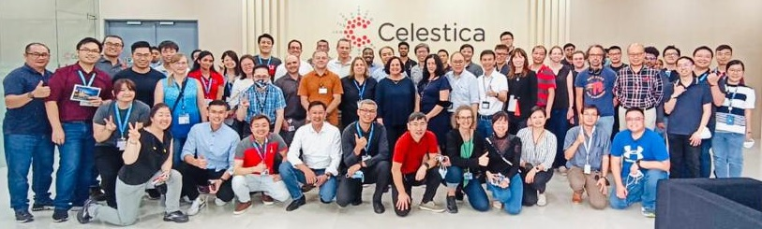
G5 A-Lo HPMM PA/PE
M5 BR1 Mfg Readiness
Prepare by Gen5 HPMM PA NPI Team
PM: Khoo Kah Lok, Boon Tee Kai, Harbans, Kenneth, Andrew, Mike, Mark, Soon Hock, Angeline
SM: Dennis Ho, Marianna M
Partnership: Tuck Sun (FA), Tay Wak (IT)/Chung Tat (IT)
Report for Nov’23
(17) L/P Manufacturing Check sheet - Smartsheet.com

Slide 2
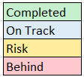
M5 Tracker for Burst Run
Updated: 5-Nov-2023
In Overall:
M5 Burst Run1 has no major issue in Z1-Z3 despite some challenges.
Zone4 daily output is lower than plan due to constrain of reclaim within same lot.
Thus, shipment estimate date get impacted.
 | Build | Body Size | Hours of Run | SKU | POST | Z1 Start date | Z2 Start date | Z3 Start date | Z4 Start date | Target shipment date
1 | Burst Run1 | BRU A1 | 4 hrs | 7FP01A | 269572 | 16-Oct | 17-Oct | 18-Oct | 25-Oct* | 31-Oct* -> 7-Nov
2 | Burst Run1 | BRU A2 | 6 hrs | 7FP39V | 269573 | 19-Oct | 19-Oct | 20-Oct | 26-Oct* | 2-Nov* -> 7-Nov
3 | Burst Run1 | BRU LG | 6 hrs | 7FP43A | 269574 | 23-Oct | 23-Oct | 25-Oct | 1-Nov* | 6-Nov*
4 | Burst Run1 | BRU A1 | 8 hrs | 7FP01A | 269575 | 26-Oct | 26-Oct | 27-Oct | 3-Nov* | 8-Nov*
5 | Burst Run1 | BRU LG | 8 hrs | 7FP43A | 269576 | 31-Oct | 31-Oct | 1-Nov | 7-Nov | 10-Nov
Zone 1 having tooling issues (POST269575) that cause low output on first day, manage to catch up on second day. Chain effect to subsequent Zones to delay start.
Zone 1 & 2 ran with challenging on resources (CAP resources on MC & EL).
Zone 3 have power supply issue for APQT.
Proposed to revise Zone4 date and shipment date by 1 week from original schedule. (Zone 4 CLT constrain on reclaim activity - require extra time to reclaim pen under same lot id.)

Slide 3
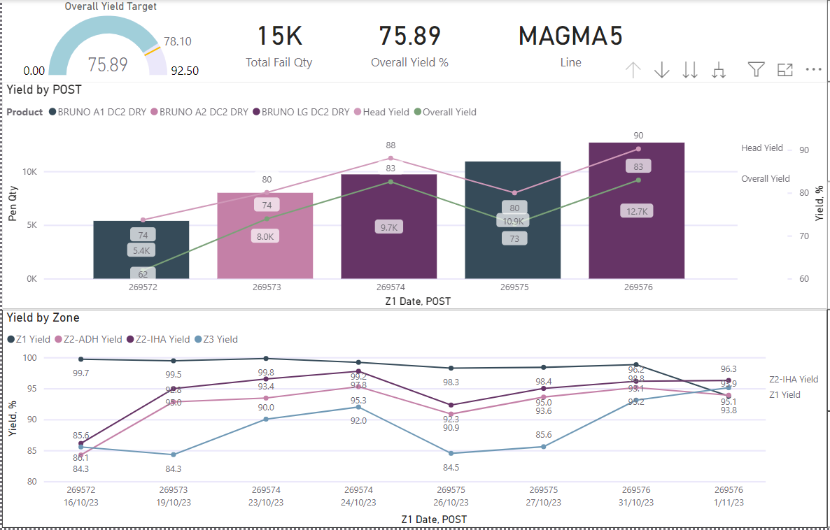
M5 Burst Run 1 Yield
Updated: 5-Nov-2023
Overall yield & head yield showed BRU LG meet target but not for BRU A.
HY Target 86.00%
Target 78.00%

Slide 4
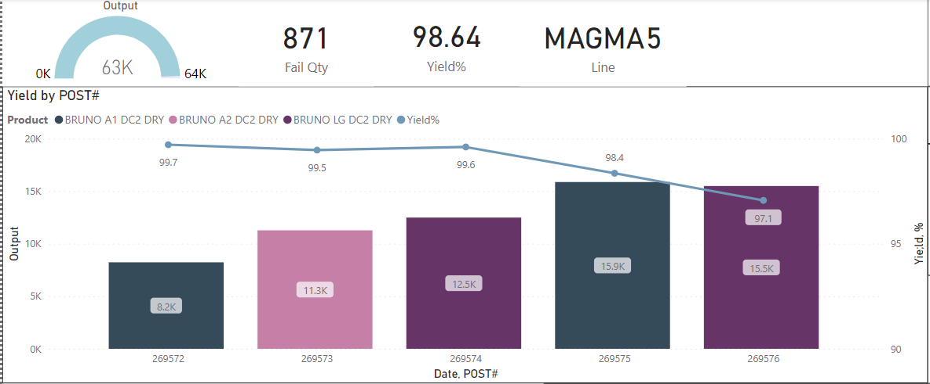
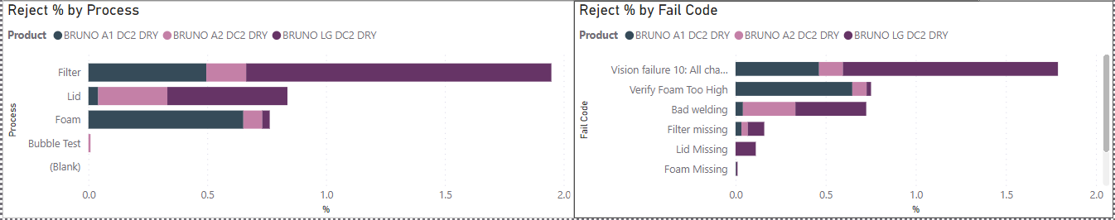
M5 Burst Run 1 Yield
Updated: 5-Nov-2023
Zone 1 yield meet target for all the POST but last 2 builds yield low due to over reject for filter vision.
Target 95.00%

Slide 5
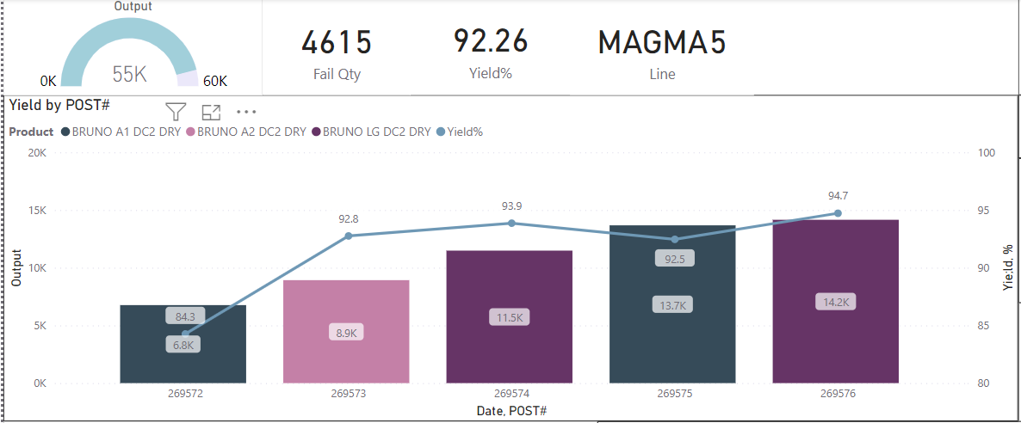
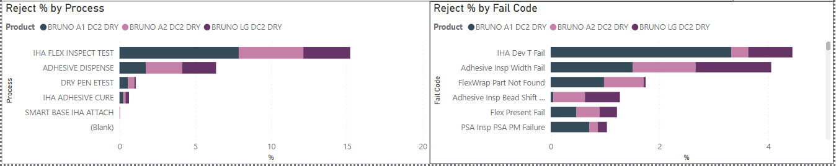
M5 Burst Run 1 Yield
Updated: 5-Nov-2023
Zone 2 overall yield hang around target and POST 269572 poor as reject adhesive inspect width fail & finetune.
Target 93.00%

Slide 6
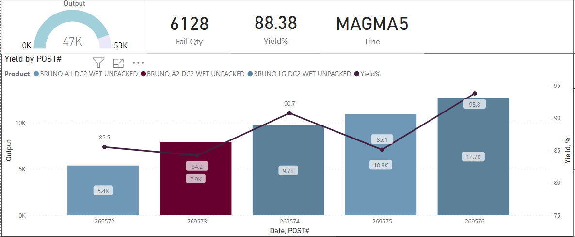
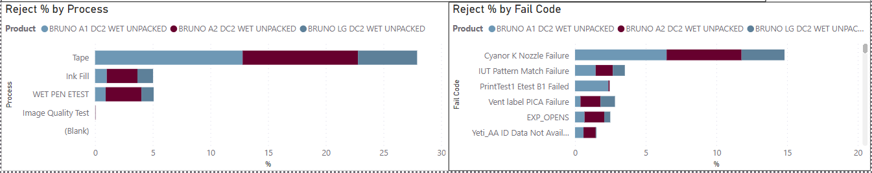
M5 Burst Run 1 Yield
Updated: 5-Nov-2023
Zone 3 BRU LG yield slightly poor to meet target but BRU A have gap on IUT to meet MR target.
Target 92.00%

Slide 7
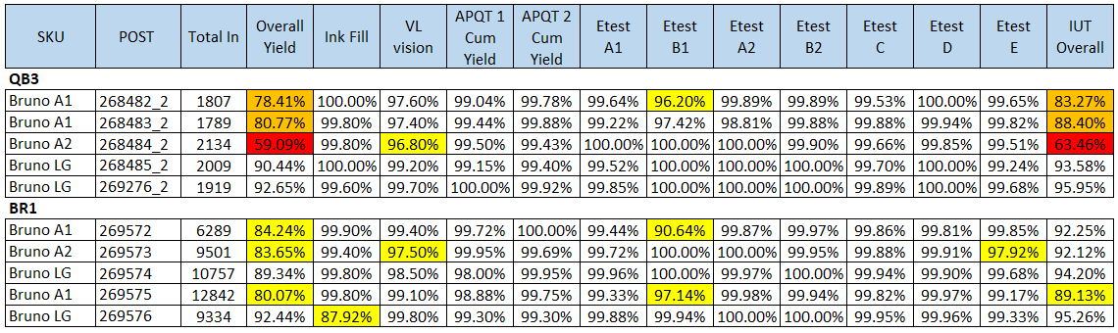
M5 Burst Run 1 Yield
Updated: 5-Nov-2023
M5 Z3 IUT yield showed improvement for BRU A pens after new dampers and stoppers installation during BR1. Team continue to monitor the performance.
- CRV team working on secondary clean to enhance IUT yield performance POST WK0.

Slide 8
M5 Overall CPM Dashboard
M5: Adam(Lead), Chee Lum, Ben, Damon, JQ, Hui Lin, Shiaw Mei, Naiza
No issue
Medium Risk – With Path Forward
High Risk– Pending Path Forward
Test in progress
Area | Parameter Name | QB1 | QB2 | QB3 | BR1
Zone 1 | Foam Clear Body Audit
 | PDLK
 | Filter Bubble Test
 | Z1 CPM VI
Zone 2 | DSC (adh. curing %) | Below Target 75% | Below Target 75% | Below Target 75% | Pending MML
 | IHA Pop Ad. Audit
 | IHA Plasma Dyne (Bru)
 | Z2 CPM VI | Func.: 17.73% | Func.: 9.66% | Dog Ear: 0.59% F: 2.67% | Func: 4.56%
Zone 3 | SBP (ppk)
 | Tape Blow Out Test |  |  | Ink Leak: 1.63% (2/122)
 | SAV |  |  |  | Pending MML
 | Altitude Test |  |  |  | 1.57% (3/197)
 | Filter Puncture Check
 | Gross Pen Weight (ppk)
 | Z3 CPM VI | LG Vent label: 26.88% LG Flex bent: 1.12% | LG Ink on vent: 33.76% Func: 0.12% | Func: 0.40% | Cat.: 0.04% Func:0.00%
LPQ | LPQ VI Plot (DOA) | BED: 0.5% |  |  | Yet to complete
 | Offline E-test |  |  |  | 0.63% (1/158) post KET
 | Print test (NH)
MLT | Mini Lifetest | LG: OOS | LG:OOS | A2: OOS | LG OOS
Zone 4 | Z4 CPM VI |  |  |  | Yet to complete
 | Latent IUT – 96h | Latent: 1.04% Suspect handling |  |  | Yet to complete
Key Takeaways:
Zone | BR 1 Build Comment
Z1 | No major issue.
Z2 | BR1 DSC measurement pending. CPM2 VI functional defects are incoming IHA defects: POM adhesive abnormal, Resin separation, SU8 damage/contamination
Z3 | CPM3 VI detected 1 Catastrophic Gross IUT slip through due to folded tape. (First slip through case in M5) Latest vision rev. should be able to detect, pending roll in by Vision Eng Tai Keng. (TBD) Validate Z4 IUT vision, vision able to failed the pen. Altitude test detected 3 pens (1.57%) nozzle drool, re-pull pens from same ink fill nest pass → pending SAV to confirm.
LPQ | 1 pen (0.63%) failed post print E-Test. Pen sent to MML for further analysis.
MLT | BRU LG still overdeliver. Pending spec optimization.
Z4 | Yet to complete. No major issue.
AIR/Catastrophic Defect Rate reference
<0.25%
>0.25%
>0.5%

Slide 9
M5 BRU WW Build Zone 1 CPM Performance
Catastrophic
M5 Z1 PE: Chee Lum, Ben
Functional
Risk
Z1 sampling plan: 1/51 (double sampling)
QBs Overview:
Catastrophic: ~0.00% (0/942)
Functional: ~0.21% (2/942)
Functional Filter Bubble pressure
Risk: ~0.21% (2/942)
Datum scratches
Penbody scratches
BR1 Overview:
Catastrophic: ~0.00% (0/1430)
Functional: ~0.07% (1/1430)
Functional Filter Bubble pressure
Risk: ~0.77% (11/1430)
Penbody scratches
Key Takeaway:
No major issue.

Slide 10
M5 BRU WW Build Zone 2 CPM Performance
Catastrophic
M5 Z2 PE: JQ, Damon
Functional
Risk
Z2 sampling plan: 1/16 (double sampling)
QBs Overview:
Catastrophic: ~0.037% (1/2671)
Dog Ear Damage
Functional: ~9.47% (253/2671)
Incoming IHA defect
Encap splatter/satellite
SU8 damage
Risk: ~54.25% (1449/2671)
E-Test probe mark on contact pad.
Z2 excessive adhesive
BR1 Overview:
Catastrophic: 0.00% (0/3418)
Functional: ~4.56% (156/3418)
Majority – Incoming IHA defect
Minority – Z2 process induce
Risk: ~7.52% (257/3418)
Flange Scratches
Key Takeaways:
Effective dog ear damage solution → 0% catastrophic.
Improving trend shown in both Functional & Risk defects.
Notes:
Solution for Dog ear damage (done) – Lowered cylinder pressure (to trigger overload during pen misalignment in AB fixture)

Slide 11
M5 BRU WW Build Zone 3 CPM Performance
Catastrophic
M5 Z3 PE: Hui Lin, Adam
Functional
Risk
Z3 sampling plan: 1/24 (double sampling)
QBs Overview:
Catastrophic: ~6.97% (173/2483)
LG Air bubbles on vent label
LG Ink on vent (IOV)
POM cracking (TBOT)
Functional: ~0.322% (8/2483)
LG Flex Bent (QB1/2)
Risk: ~7.61% (189/2483)
Air bubbles under tape
Dry Ink Stain on side flex (minor)
Ink on Twine
BR1 Overview:
Catastrophic: ~0.04% (1/2517)
Gross IUT slip through
Functional: ~0.00% (0/2517)
Risk: ~2.50% (63/2517)
Dry Ink Stain on side flex (minor)
Tape wrinkle
Key Takeaways:
Catastrophic defects improved significantly from QBs ~6.97% → BR1 ~0.04%.

Slide 12
M5 BRU WW Build LPQ Performance
Catastrophic
M5 LPQ PE: Shiaw Mei
Functional
Risk
LPQ sampling plan: 40 pens per lot (default sampling)
QBs Overview:
Catastrophic: ~0.17% (1/600)
Early Deprime
BR1 Overview: (Yet to complete)
Catastrophic: 0.22% (1/453)
Post print E-Test failed
Functional: ~0.44% (2/453)
Functional edge raggedness
Functional significant cluster
Key Takeaways:
No further BED observed after QB1 – investigation in progress by escalation team.
BR1 detected 1 pen failed post print E-Test. Pen sent to MML for further analysis to confirm the failure mode.
Notes:
Solution for Dog ear damage (done) – Lowered cylinder pressure (to trigger overload during pen misalignment in AB fixture)

Slide 13
M5 BRU WW Build Zone 4 CPM Performance
Catastrophic
M5 Z4 PE: Naiza
Functional
Risk
Z4 sampling plan: 1/48
Z4 96h latent IUT sampling: 96 pens
QBs Overview:
CPM 4 Total audited pens: 378 pens
0% failure
96h latent IUT total pens: 954 pens
~0.10% failure (1/954)
Handling issue
BR1 Overview: (Yet to Complete)
CPM 4 Total audited pens: 590 pens
0% failure
96h latent IUT total pens: 384 pens
0% failure
Key Takeaways:
BR1 still yet to complete. No major issue so far.

Slide 14
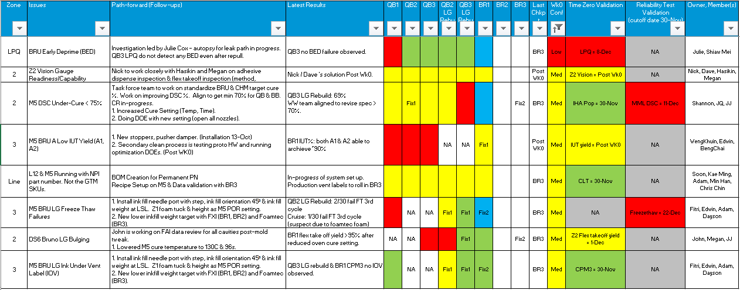
Critical Issues (M5 BRU)
Builds / Runs
Good data / Resolved
Partial Good Data / Low Risk
Ineffective Fix / Show-stopper​
Pending data​
Wk0 Conf
Hgh
Med
Low
For Week0 (Must / High Want)
Updated 5-Nov-2023
Notes:
Closure Criteria:
M5 BRU LG Freeze Thaw Failures - Passing freeze thaw testing on both FXI and foamtec up to at least 3 cycles on at least 2 sequential build M5 Kahuna Not Sending Data to Gradebook - All printer banks on M5 upgraded with data to the database BED : Less than 0.3% lot fails for deprime at LPQ for BR1-BR3 and Tolerance analysis supports variations within specs (Post WK0) X-ray : X-Ray analysis complete within two weeks, Maximum

Slide 15
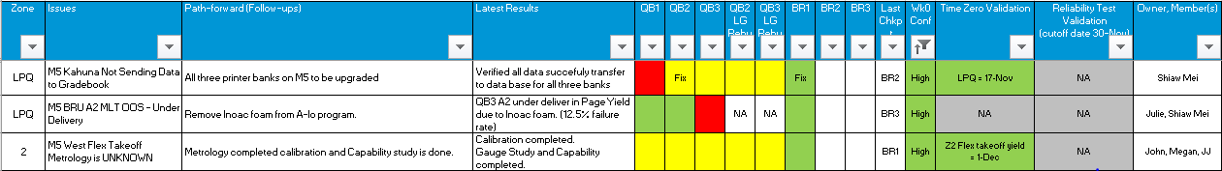
Critical Issues (M5 BRU)
Builds / Runs
Good data / Resolved
Partial Good Data / Low Risk
Ineffective Fix / Show-stopper​
Pending data​
Wk0 Conf
Hgh
Med
Low
For Week0 (Must / High Want)
Updated 5-Nov-2023
Notes:
Closure Criteria:
M5 BRU LG Freeze Thaw Failures - Passing freeze thaw testing on both FXI and foamtec up to at least 3 cycles on at least 2 sequential build M5 Kahuna Not Sending Data to Gradebook - All printer banks on M5 upgraded with data to the database BED : Less than 0.3% lot fails for deprime at LPQ for BR1-BR3 and Tolerance analysis supports variations within specs (Post WK0) X-ray : X-Ray analysis complete within two weeks, Maximum

Slide 16
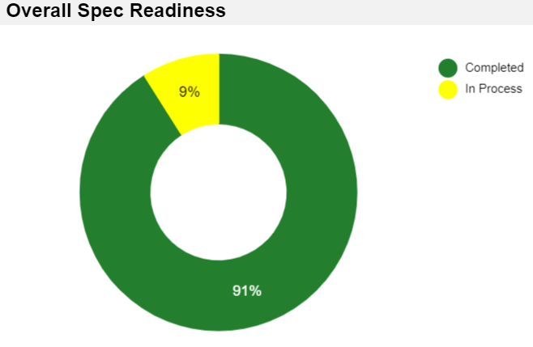
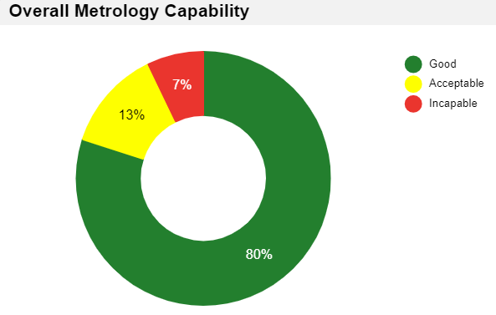
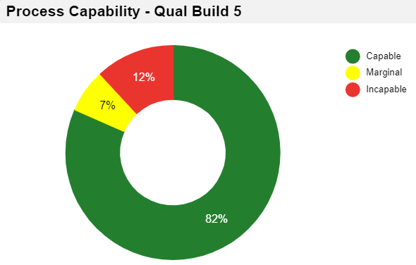
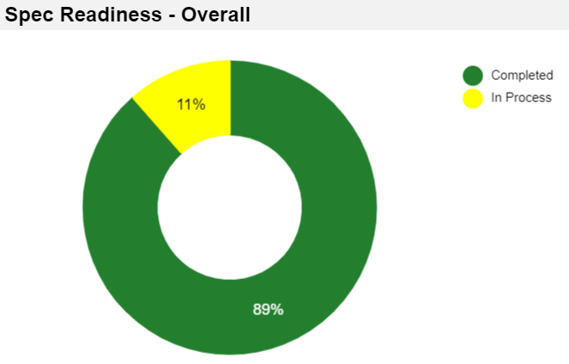
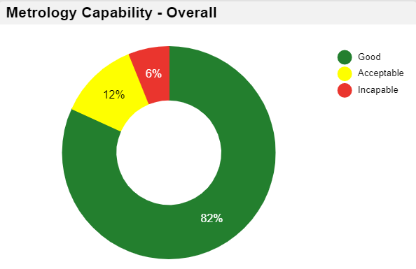
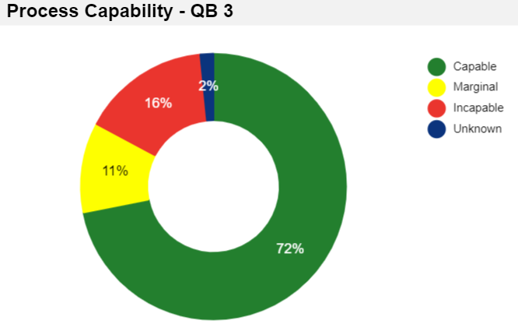
Overall Summary
Updated 3-Nov-23
L12
Total 78 spec parametric data in L12
7 in process
71 completed
Total 69 metrology data in L12
5 incapable
Total 76 process parameter data in L12
9 incapable
M5
Total 61 spec parametric data in M5
7 in process
54 completed
Total 66 metrology data in M5
4 incapable
Total 64 process parameter data in M5
10 incapable
1 unknowns

Slide 17
Back up

Slide 18
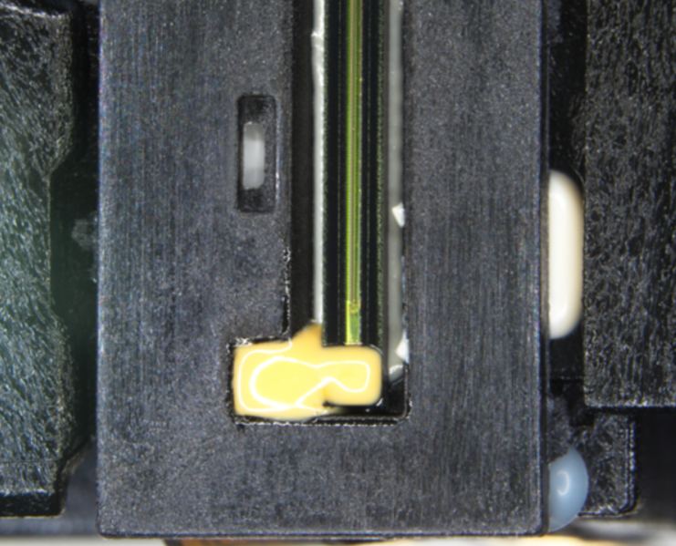
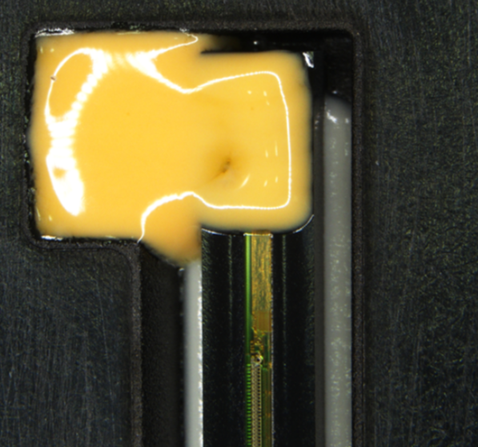
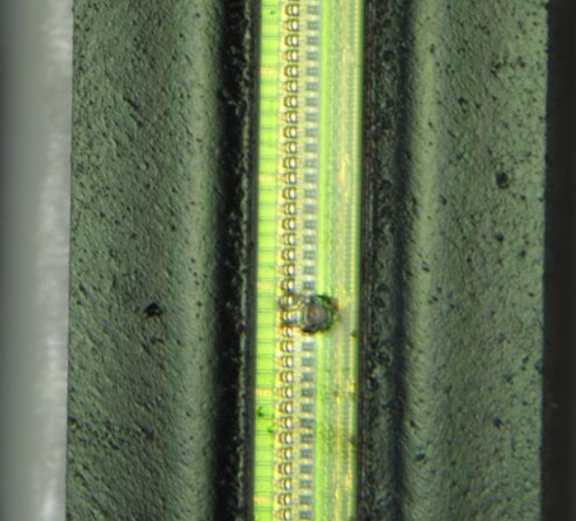
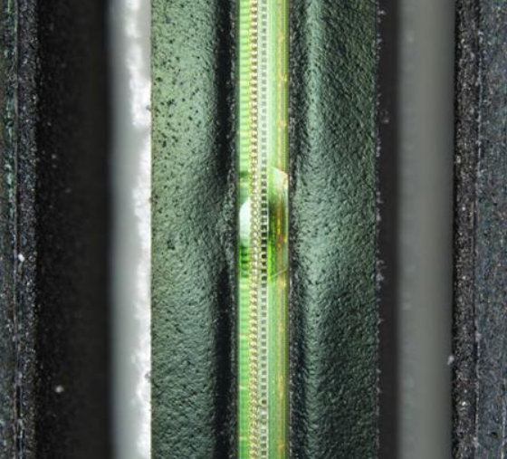
Z2 Functional Defects Examples
POM adhesive abnormal
SU8 related
Resin separation
SU8 related

Slide 19
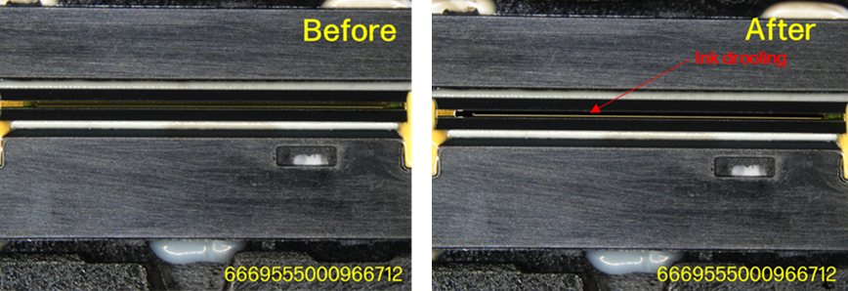
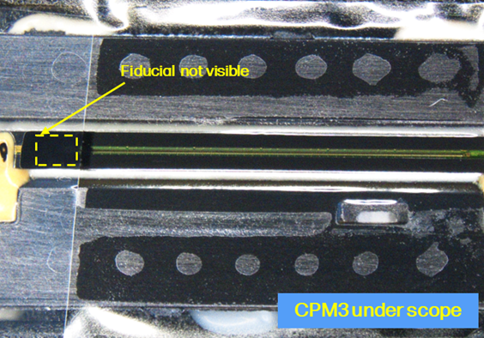
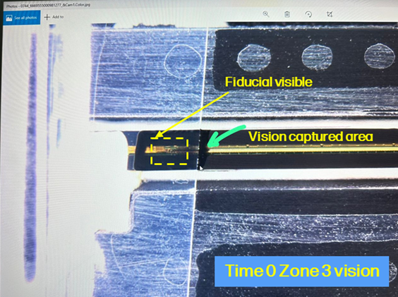
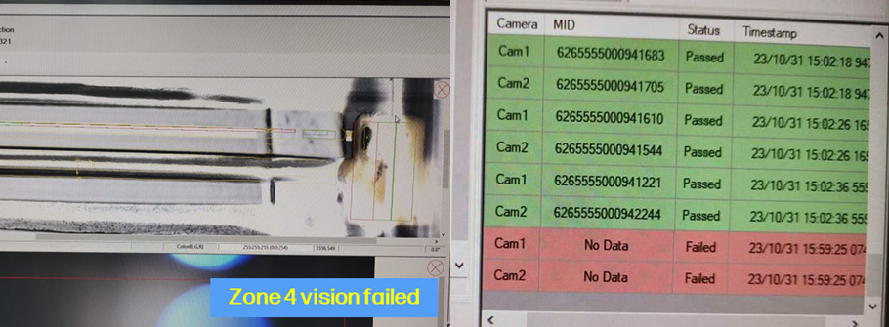
Z3 Defects Example
Altitude test
Nozzle level drool

Slide 20
PA Spec Readiness– M5
Updated 3-Nov-23
Processing Area | Spec Readiness Owner | Parameter Name | Remark
Zone 1 | Natiel Gomez | Lid weld collapse height | Aligned with CRV to remove from CP. CR 509458 submitted – Pending review
 |  | Lid Weld energy | Aligned with CRV to remove from CP. CR 509458 submitted – Pending review
Zone 2 | Devin | Fluidic Bead 1 Width | Pending spec justification from CRV NPI process – Devin
 |  | Fluidic Bead 1 Height | Pending spec justification from CRV NPI process – Devin
 | Robert H Weber | Flex Stake - Dimple Flex Region Surface Profile | Pending spec justification from CRV NPI process – Robert
 |  | Flex Stake - EI Pads Flatness | Pending spec justification from CRV NPI process - Robert
 |  | Flex Stake - EI Pads Surface Profile | Pending spec justification from CRV NPI process - Robert
Total 61 spec parametric data in M5
7 in process
54 completed

Slide 21
PA Metrology Capability – M5
Updated 3-Nov-23
Processing Area | Process Owner | Parameter Name | Remark
Zone 2 | Damon Chan | Panel Level Plasma wettability audit | Pending re-do kappa due to multiple external factors that affect the results.
 | Chris Chin, Hasikin Widjaya | Fluidic Bead 1 Width | Need 1 week downtime and support from Vision Engineer to understand and make it capable
 |  | Fluidic Bead 1 Height | Need 1 week downtime and support from Vision Engineer to understand and make it capable
 | Damon Chan | Fluidic Adhesive Minimum Coverage Width Post IHA Pop (IHA imprint) | This parameter is still being discussed in the Z2 product team, it will not ever pass the capability due to different judgement of the bead width section.
Total 66 metrology data in M5
4 incapable

Slide 22
PA Process Capability QB3 – M5
Updated 3-Nov-23
Processing Area | Process Owner | Parameter Name | Remark
Zone 2 | Tan Jia Jan, Megan | West Takeoff Threshold
Zone 2 | Anthony Soon | POM Alignment - EMC Theta-X to Body[BAC]
Zone 2 | anthony.soon@hp.com | POM Alignment - Sliver Target Centerline Theta-Z
Zone 2 | Chris Chin, Jia Jan Tan | Fluidic Bead 1 Height
Zone 2 | Chris Chin, Jia Jan Tan | PSA Attach - Centerline Theta-Y
Zone 3 | Hean Jun Edwin Koay, mohammad.shuib@hp.com | Net Ink Weight - ISO 1200
Zone 3 | hean.jun.koay@hp.com, Weng Khuin Teh | IUT & Tent Line - Machine Vision 1st Pass
 | Wong Beng Chai | Vent Label Location relative to Lid Alignment Mark (X)
 |  | Vent Label Location relative to Lid Alignment Mark (Y)
 | Shiaw Mei Gan | LPQ PICA Code Verification | There has been some delay in the software development. Plan to roll in by BR3, which is late Nov.
 | Shiaw Mei Gan | Mini Life Test - Fail Rate
Total 64 process parameter data in M5
10 incapable
1 unknown
Added 2 new parameters re-categorized to incapable
Vent Label Location relative to Lid Alignment Mark (X)
Vent Label Location relative to Lid Alignment Mark (Y)

Slide 23
Help Needed
Updated 3-Nov-23
Line | Processing Area | Parameter Name | Remark | Owner | Status
M5 | Spec Readiness | Lid weld collapse height | CR 509458 submitted – Pending review | Natiel Gomez | Open
 |  | Lid Weld energy
 |  | Fluidic Bead 1 Width | Pending spec justification from CRV NPI process. M5 to do another round of spec justification? Or just correlation | Robert H Weber/Devin | Open
 |  | Fluidic Bead 1 Height
 |  | Flex Stake - Dimple Flex Region Surface Profile
 |  | Flex Stake - EI Pads Flatness
 |  | Flex Stake - EI Pads Surface Profile
 | Metrology | Fluidic Bead 1 Width | Need 1 week downtime and support from Vision Engineer to understand and make it capable | Hasikin/Nick/Devin | Open
 |  | Fluidic Bead 1 Height
 |  | Panel Level Plasma wettability audit | Pending re-do kappa due to multiple external factors that affect the results. | Damon Chan | Open
 |  | Fluidic Adhesive Minimum Coverage Width Post IHA Pop (IHA imprint) | Pens from CRV received. Pending redo GR&R. ETC Mid of Nov | Damon Chan | Open

Slide 24
Action items
Updated 3-Nov-23
Send the metrology data to Matt, he will help to check if it is capable or incapable
Pending data sharing.
Re-check with M5 Z2 team on Metrology 1 week downtime, is the engineer request for 1 week downtime, doing nothing in Z2 other than Vision? Or they can resolve the vision issue while running the line ?
Feedback from M5 Z2 - 1 week downtime is to troubleshoot the vision and re-run the GR&R (One leg at one time). Chris has allocated 13th Nov week for the mentioned activities.

Slide 25
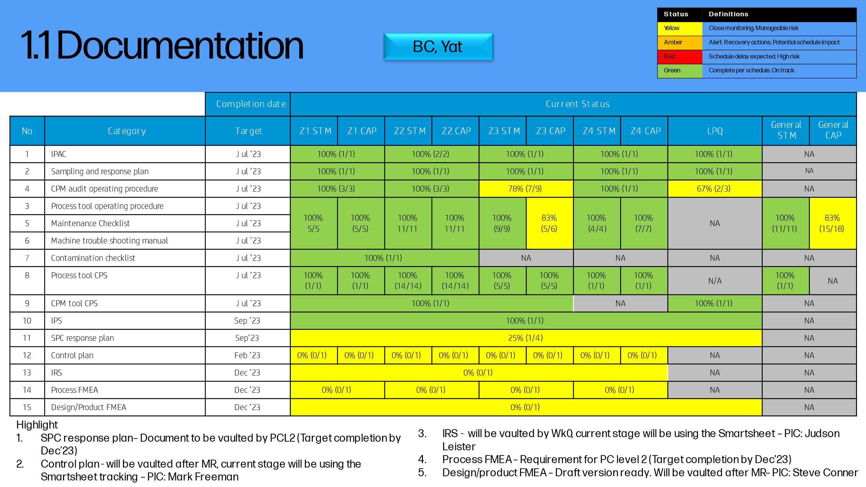
Updated 30-Oct-2023

Slide 26
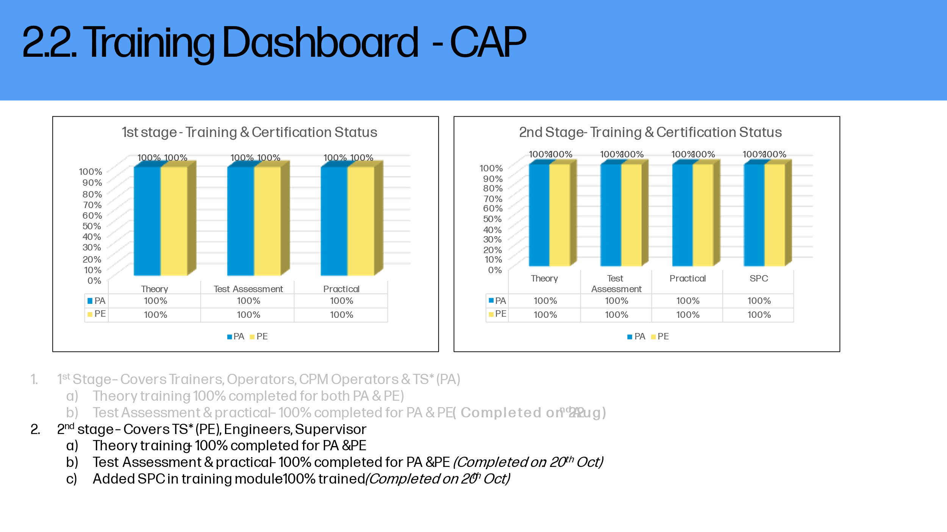
Updated 30-Oct-2023

